Slide 1

Be Purpose Driven
And the Goals Will Take Care of Themselves
Jim Allen
Jim.Allen@ResponseResource.com
MBD has been reviewed and approved as a provider of project management training by the Project Management Institute (PMI ). MBD is a member of PMI’s R.E.P. Program and PMI does not specifcally endorse, approve, or warrant MBD ’s products, courses, publications, or services.

Slide 2
Goal Oriented Project Management
“The purpose of project management is to foresee or predict as many dangers and problems as possible; and to plan, organize and control activities so that the project is completed as successfully as possible in spite of all the risks.”
Burek, Paul (2008). Creating clear project requirements: differentiating "what" from "how" Paper presented at PMI® Global Congress 2008
Notes:
How many of you believe that this is a good purpose statement for Program and Project managers?
Does completing successfully include delivering meaningful value or just meeting the goals set in the project charter?
Most program managers are goal oriented they need to hit budget, meet the schedule and stay within the scope provided by the client
What is missing?

Slide 3
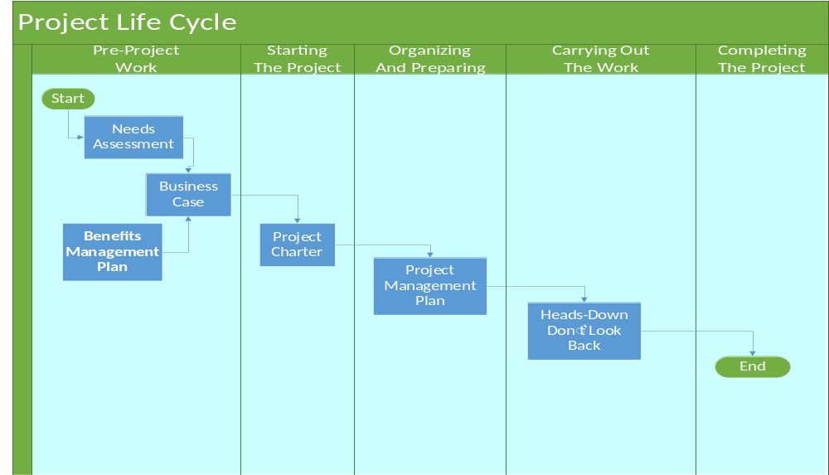
Current Project Life Cycle Remains Somewhat Linear
Works Well for Predictive Workflow
PMBOK v6
Notes:
If you look at earlier versions of the PMBOK, the concept of pre project work was to produce a business case. Then the business case was turned into a charter, the charter into a PMP.
We then had a solid representation of the stakeholder needs and the benefits that they expected to receive.
We can now put our heads down and go to work.
Click
This works well for highly predictive solutions. It does not work well for dynamic problems, which is the more likely case that we find in today’s programs.

Slide 4
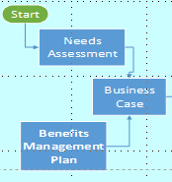
Does the Sponsor Always Communicate the Purpose?
“The WHY of the Project”
“The project sponsor is generally accountable for the development and maintenance of the project business case document.”…”A needs assessment and benefits plan precede the business case.”
But,
Development and maintenance of the project’s benefits plan is an iterative activity.
PMBOK v6
Notes:
How often does a customer really understand why they're doing the project? How often do you have a need assessment or benefit plan when you start work? Do you need this information if you are going to deliver meaningful solutions?
Click
Determining the why of the project is I an iterative process. PMs must learn to illicit the whys from the stakeholders.
As we have learned in the Agile process, each time we build another build we learn more about the problem that customers trying to face how do we handle it?

Slide 5

Purpose Driven Project Management
The purpose of project management is to make the client successful by identifying the underlying needs of the client and satisfying those root causes (Success is not about the just meeting requirements, it’s about fulfilling the “why” behind requirements.)
Notes:
What do you think about this definition of purpose driven project management?
If we are purpose driven, we're putting the emphasis on the client and trying to make sure we understand the root causes of the pain that the client is facing.
Success is defined by satisfying the why behind the requirements.
Success is resolving the pains experienced by the client, even if they were not able to communicate properly.

Slide 6
The Why (Purpose) of a Project Has Grown in Importance
Determine Information and communications needs of stakeholders (PMBOK version 2.0) focused on project reporting and information sharing.
Manage stakeholders (PMBOK version 3.0)
Manage Stakeholder Expectations (PMBOK version 4)
Project Stakeholder Process split from overall project communications - Effectively engage stakeholders throughout the project life cycle, based on the analysis of their needs, interests, and potential impact on progress success. (PMBOK version 5.0)
Benefit Management – A project benefit is defined as an outcome of actions, behaviors, products, services, or results that provide value to the sponsoring organization as well as the project’s identified beneficiaries. Development and maintenance of the project’s benefits plan is an iterative activity.(PMBOK version 6.0)
Notes:
Show PMBOK books to indicate expansion in complexity
The Program Management Institute has shifted from a goal oriented point of view to one of stakeholder focused program management.
Version 2, the version I originally studied really did not address stakeholders very much
Some material was added in version 3 that began to address stakeholders, but it was oriented toward reporting information to stakeholders, not gathering information.
Managing stakeholder expectations was added in version 4.
Now in version 5 and 6 of the PMBOK, there's a whole new chapter dealing with stakeholder engagement
The problem that we face is that we now know that we should be engaging with stakeholders but there is very little material telling us how we should engage. We are process oriented and we need a process to follow to achieve the desired results.

Slide 7
Current Best Practices Require an Understanding of “Why?”
Four Values of the Agile Manifesto
Individuals and interaction
Working software
Customer collaboration
Responding to change
Principles That Drive Purpose Driven Projects
Our highest priority is to satisfy the customer through early and continuous delivery of valuable software
Welcome changing requirements, even late in development. Agile processes harness change for the customer’s competitive advantage.
Business people and developers must work together daily throughout the project.
Agile Practice Guide
Notes:
This is further emphasized in the agile manifesto.
Now our highest priority is to satisfy the customer through early continuous delivery of valuable software while welcoming change requirements.
We must not avoid change requests.
We should welcome scope creep.
We should examine stakeholder dissatisfaction.
Change, scope creep and dissatisfaction are ways that stakeholders try to communicate their pain. We must pursue them if we are to deliver solutions that truly resolve customer pain.

Slide 8
New Role of the New Project Managers
 | TC*- Paradigm | PVM Paradigm
Paradigm Focus | Satisfy Predefined Objectives | Maximize Project Value
Paradigm Perspective | Operational | Strategic
Project Manager's | Satisfy Requirements | Create Value
Responsibility
Project Definition | Define Requirements | Identify Customer Needs
Project Planning | Baseline | Centerline
Project Execution | Minimize Variation | Identify Opportunities
Protect Manager's Role | Project Administrator | Project leader
*TC – . The TC-Paradigm mainly focuses the management of projects on planning and conformance with schedule, budget, and scope during the implementation
of projects. PMBOK 4th Edition
Notes:
A purpose driven value management view of program/project management requires a closer relationship with stakeholders than the ones we used to have in the triple constraint world of schedule, scope and budget.
What do we mean by baseline vs Centerline? Baselines imply rigidity while centerlines infer guidance as we move down the road toward a solution.
How do you feel about Minimize Variation vs Identify Opportunities?
Haven’t we been taught constraint? Build the plan, stick to the plan, deliver. Is it strange to look for additional opportunities to help customers resolve their pain?
Oh yes, Satisfy Requirements vs Create Value?
What does that mean and how do you do it?

Slide 9
Purpose Driven May Imply an Iterative Based Life Cycle
Requirements
Analysis
Design
Build
Test
Requirements
Analysis
Design
Build
Test
Requirements
Analysis
Design
Build
Test
Repeat as Needed
Requirements
Analysis
Design
Build
Test
Requirements
Analysis
Design
Build
Test
AGILE Practice Guide
Notes:
What we need to do is change this process of some semi waterfall where we get all the facts up front and put our heads down and carry out the work
Click
to one that's more iterative doing requirements analysis design iteratively each time until we finally delivered the final project. We need to constantly look for solutions that resolve stakeholder pain.

Slide 10
The Continuum of Life Cycles
High
Agile
Incremental
Continuum
Frequency of Delivery
Predictive
Iterative
Low
Degree of Change
High
AGILE Practice Guide
Notes:
If a project is very predictive, you don't have much change in a project you can actually build using a waterfall or one or 2 release approach.
When the frequency of delivery goes up or the degree of change becomes greater, you have to move to a full agile process where the customer is involved almost on a day-to-day basis to tell you what you're doing right and what you're doing wrong

Slide 11
Understanding the Need to Know Why is Not New
“He who has a why to live for can bear almost any how”
Friedrich Nietzsche (1888) “Twilight of the idols”
“Until thought is linked with purpose there is no intelligent accomplishment”
James Allen, circa 1903. “As a Man Thinketh”
“He [who] knows the "why" for his existence... will be able to bear almost any ‘how’.".
Viktor Frankl (1959) in Man’s Search for Meaning
“Until we understand the ‘why’ of a requirement, we do not understand the requirement.”
Jim Allen, circa 2018
Notes:
Understanding the concept of Why is not new.
Once we understand the “why” it becomes much easier to understand the what and the how.
It boils down to a simple concept, until we understand the why of a requirement we really do not understand the requirement.

Slide 12
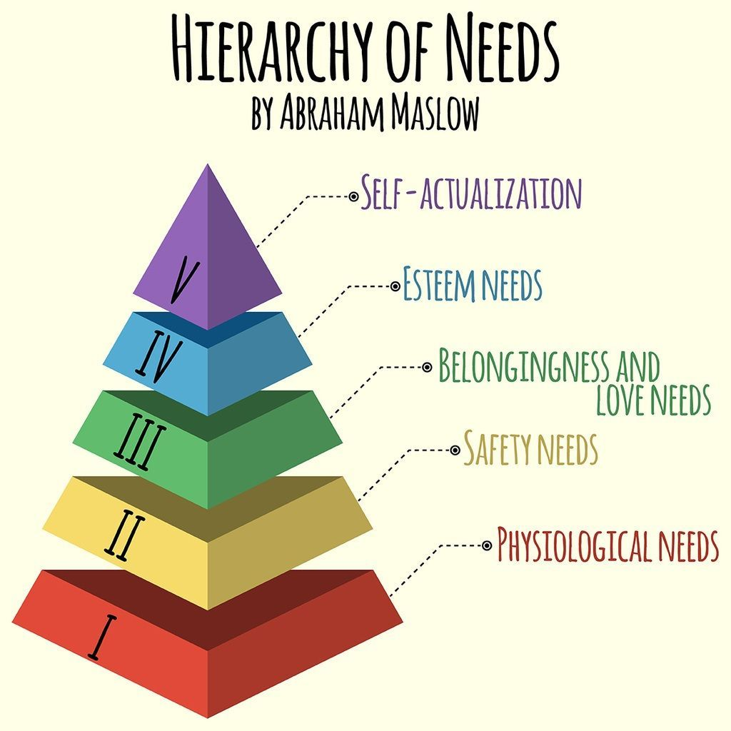
What Motivates us as Project Managers?
Bottom three may enter in to our day to day work-life, but,
How do the top two relate to our role as project managers?
How do they relate to our job satisfaction?
How do they relate to client satisfaction?
Notes:
We are each motivated by our underlying needs.
Let’s assume that the bottom three needs are fundamental and probably not related to our project management job motivation.
However, the top two are directly related.

Slide 13
What Drive Us as Project Managers?
Esteem Needs
We want respect from others. We want a sense of achievement in the work that we do. We want the self confidence necessary to measure our self-esteem. Esteem presents the typical human desire to be accepted and valued by others.
Self-Actualization
Once we have self-esteem, we need to feel that we have purpose. We need to understand that our inner potential is valued by others. We need to be creative.
We want to be perceived as good people, doing the right thing.
Notes:
We are each motivated by our need to be respected by others. We want to feel a sense of achievement.
Once we have the feeling of self-esteem, we need to feel a sense of purpose. We want our work valued by others.
We need to understand how we are motivated before attacking the issue of what motivates clients.
Click

Slide 14
The Client-Motivation Formula
Motivation =
(
D
+ V
+ K
)
D = Dissatisfaction (either internal or external)
V = Visualization of the desired end or result
K = Knowledge of how to get there
BUT
Motivation must be sufficient to overcome the pain of change
PC < PTI = TC
Notes:
What motivates clients?
click
First, they have to be dissatisfied with their current state.
Their status quo is just not working.
Click
Second, they need to be able to visualize the desired future state. That is part of our job as program and project managers we have to help them visualize the to be state where their dissatisfaction will no longer exist.
Click
Third, you have to have the knowledge of how to get there.
With those three components, they will be properly motivated to work side by side with developers side by side with the engineers to come up with a usable solution.
Click
They will only change (TC) if the pain that they are in, PTI is greater than the pain of making the change, PC.

Slide 15
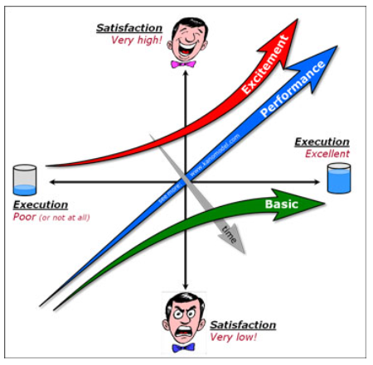
The Kano Model
Excitement
Simply stated, these are the requirements that are unexpected and pleasant surprises or delights. These are the innovations you bring into your offering. They delight the customer when there, but do not cause any dissatisfaction when missing because the customer never expected them in the first place. Kano originally called these “Attractive or Delighters” because that’s exactly what they do.
Basic
Simply stated, these are the requirements that the customers expect and are taken for granted. When done well, customers are just neutral, but when done poorly, customers are very dissatisfied. Kano originally called these “Must-be’s” because they are the requirements that must be included and are the price of entry into a market.
Discovery of Purpose Creates Satisfaction
See the Lean Product Playbook by D. Olsen
Prof. Noriaki Kano created the Kano Model in 1984
Notes:
In about 1984, Professor Cano came up with this concept.
He said that if you only do what the customer wants you simply deliver the stated requirements as they were written in your obligation, maybe is written in your project charter they'll consider you to be a vanilla developer, a vanilla project manager.
You are doing what they are paying you to do, nothing more and more nothing less.
Click
If you are to generate excitement you have to find problems the client did not even know they had and propose solutions. This added value become delighters, resulting a customer that is much happier with you and much happier with the resulting solution.
As a side benefit customers will come back to you and ask for more over the coming years
Click
You will also find this in “the lean product playbook” by Dan Olsen

Slide 16


Why Do We Put Goals Ahead of Purpose?
Business Leaders that think that Purpose is central to business success
34%
79%
Business leaders whose organization’s purpose is a guide post for decision-making of their leadership team.
PWC’s “Putting Purpose to Work Survey”
Notes:
Price Waterhouse Cooper conducted a very interesting study.
They found that79% of business leaders believe that purpose is central to success but only 34% consider purpose in guiding their decision making.
As PMs do we fall into the share that characteristic.
I hope not.

Slide 17
Value of Purpose in the Workplace
PWC’s “Putting Purpose to Work Survey”
Notes:
There's even a further value in being a purpose in the workplace.
The employees are extremely happy when they can find meaning in day-to-day work.
They find that when they solve problems for somebody else, they see meaning in their day-to-day work.
Business leaders are more worried on the right side they're worried about reputation, distinction and differentiation
We have to come up with a happy medium

Slide 18
Purpose Must be Communicated to the Team
“Employees most favor hearing about the impact of their company’s products and services through client and customer stories, employee stories, and leadership messages.”
PWC’s “Putting Purpose to Work Survey”
Notes:
This is another interesting observation made by PwC.
Employees, the people that are doing the work gain more satisfaction from hearing that the clients that they're doing the work for benefited by the work.
Everybody likes to say This is why I've been doing this work, this is why I’ve put in those long hours.
This is why I have been sweating and toiling.
I know that the people that I did this for are benefiting from my work and their appreciative.
This is even more important that money.

Slide 19
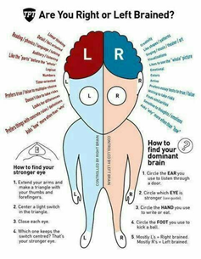
Why Project Managers Struggle
Left Hemisphere
Right Hemisphere
Short Term
Long Term
Schedule Focused
Business Focused
Build the Right Way
Build the Right Solution
Notes:
Why do project manager struggle with being purpose driven project managers?
The main reason is that project managers have been taught to be short term, schedule focused. They have a tendency to be process and goal oriented. They concentrate on doing things the right way.
Let’s look at how the brain seems to work.
In general, the left brain is short term schedule focused. Left brain thinkers follow the rules and follow the process to build a solution correctly
Click
The left brain wants to build the solution the right way.
Click
The right brain thinkers are more long-term thinkers. They ask questions like, where is this customer going to be after I come up with solutions. They are more business focused.
They are focused on building the right solution
Click

Slide 20
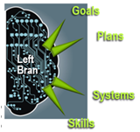
Goal Oriented Projects Usually Depend on Short Term Tactical Thinking
Quantitative
Internally Focused
Position of Scarcity
Task Oriented
Short Term Revenue Focused
Our Left Brain Focuses on the Near Term
Notes:
When you are goal oriented you have a tendency to have a short-term point of view
Click
You are quantitative.
You are internally focused
You operate from a position of scarcity
Your are task oriented
Your are short-term revenue focused
What does it mean to be in a position of scarcity?
Well you have a very finite set of options when your goal oriented the boundaries have been predefined for you in his hard to go outside of those you can exceed the budget you can't go forward and ask for changes in scope to match what the client really needs you can't take a little bit more time because the schedule going to have is so tight and so focused.
Click
The left brain focuses on the short-term objectives

Slide 21
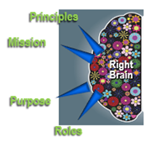
Purpose Driven Projects Rely on Long Term Strategic Thinking
Qualitative
Externally Focused
Position of Abundance
Lead and Manage
Creative
Long Term Business Oriented
Our Right Brain Focuses on Strategic Concerns Building Trust
Notes:
Meanwhile the right brain is worried about the principles of doing the right thing for people.
It is about having a mission of being recognized as a contributor to the clients benefit.
Click
It's really broken down into more qualitative nature it is more externally focused.
You are not looking at yourself internally but looking at how you effect other people.
You have a position of abundance as opposed to what I said before.
If your world is open to welcoming change, you feel free to look for the problems and look for the difficulties that people are having.
There is never a shortage of difficulties to identify.
Yes, you must prioritize. You must find ways to fund. You must address these new problems.
Just remember you will never run out of problems to solve.
Click
You want this customer to appreciate what we've done and want us to do more for them in the future.
Alleviating pain builds trust. We want to build trust that's the secret of dealing with people

Slide 22

Leadership and Ethics in Project Management
Leadership & ethics are about:
Who you are as an individual.
Your value to the client in the
business relationship.
Your character.
Notes:
You need to understand the leadership necessary to be effective.
you need to understand yourself
Your need to understand your true value to the client
What is your character?
Are you interested in only the money that's going to come to you at the end of the week.
I was working with students at a training session and started to compare the sleazy salesman approach as opposed to the modern salesman or the modern program manager that reached back into their character their foundation and does the right thing by their clients

Slide 23

Project Managers Require a Strong Character
Your character is the sum of:
Your principles and values.
Your ethics.
Your mission and purpose.
Your role & responsibility with clients.
Your principles, values and ethics anchor your behavior in your Project Management role.
Notes:
Character is built up by the principles of values that you learn from your family. Your ethics that you’ve established for yourself and for your company define your mission and purpose of what you're trying to do in life.
They define your role and responsibility to your clients.
Click
Your principles and values and ethics should anchor your day-to-day activities.
If they do, you will be a much more effective project manager

Slide 24

Project Management Purpose
What are the characteristics of Purpose?
Long-term external thinking.
What makes us selfless.
Qualitative and subjective.
How do we serve others.
The Why of Our Efforts
Notes:
What are the characteristics of Purpose?
It is long term external thinking
It is selfless
It is qualitative and subjective
It is what we do to serve others
Click
it's why we go to work every day

Slide 25
Project Management Goals
What are the characteristics of goals?
Specific
Measurable
Attainable
Realistic
Timely
Metric Driven (Left Brain)
Notes:
Does that sound like the Pre version 5 of the PMBOK?
What are goals?
They are specific measurable attainable realistic and timely.
They are metric driven. what is my CPCI?
How am I doing against schedule?
How can I know that I've done it on time and met the check points.
Have I delivered what I have been contracted to deliver?
Have I met the marks on my plan
Have I delivered what I am supposed to deliver in spite of whether or not the client is achieving their desired results
Click
The left brain is Metric Driven

Slide 26

Balancing Purpose and Goals
What is your Purpose in Project Management?
What is your Goal in Project Management?
Do You Own and Communicate Your Purpose?
Notes:
Know your purpose,
Know your goals
Own both and communicate them with your stakeholders and management.
This is a balancing act.
Your stakeholders are a big part of the act

Slide 27

Keep Purpose Ahead of Goal
PURPOSE = TRUST
GOAL = METRICS
Client Wins
You Win
Always keep Purpose ahead of goal
Notes:
One thing you should walk away with is “write this down and remember each day” always keep your purpose ahead of your goals always look at it from the customer's point of view or from the client's point of view or the department's point of view.
Back in 1936 a fellow named Dale Carnegie made a very interesting comment in his book “how to win friends and influence people” that I hold as a basic principle to this day: Always look at everything from the other person's point of view that will keep you out of trouble. If you do that and you stay purpose driven, all your goals will be met.

Slide 28
Purpose is Not an Initiative It is a Way of Business
“Purpose is not an initiative’ it is a way of business. It must be core to the decisions, conversations and behaviors across all levels to be authentic and deliver the wealth of advantages it promises.”
Jim.Allen@ResponseResource.com
www.ResponseResource.com
Notes:
Being purpose driven is not an Initiative; it is a way of doing business
Work to change your thought process.
Understand what you are trying to ensure client success. I you do that, you will be successful, and your clients will be successful.
They will see you as a partner. They will see you as the person that they can depend on to do the right thing.
They will see you as the person that they turn to when they are faced with new problems.
Clients never run out of problems.

Slide 29
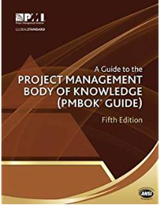
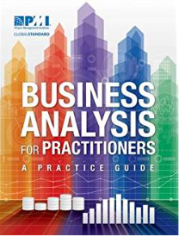
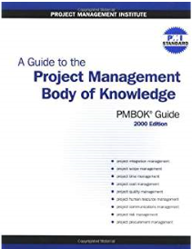
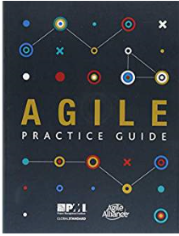
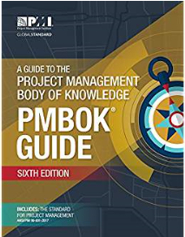

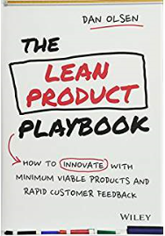
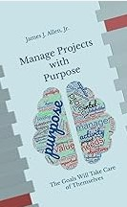



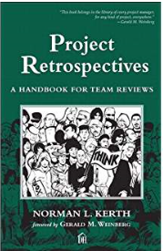

Project Management Body of Knowledge
(PMBOK Guide)-Fifth Edition
By Project Management Institute
Business Analysis for Practitioners: A Practice Guide
By Project Management Institute
A Guide to the Project Management Body of Knowledge (PMBOK Guide) -- 2000 Edition
by Project Management Institute
Agile Practice Guide
By Project Management Institute
A Guide to the Project Management Body of Knowledge (PMBOK Guide)–Sixth Edition
by Project Management Institute
Man's Search for Meaning
by Viktor E. Frankl and William J. Winslade
The Lean Product Playbook: How to Innovate with Minimum Viable Products and Rapid Customer Feedback
By Dan Olsen
Manage Projects with Purpose
And the Goals Will Take Care of Themselves
Response Resource Publications
By James J. Allen, Jr
The Secret: What Great Leaders Know and Do
by Ken Blanchard and Mark Miller
Fifty Quick Ideas To Improve Your Retrospectives
by Tom Roden and Ben Williams
Twilight of the Idols
by Friedrich Nietzsche
Project Retrospectives: A Handbook for Team Reviews (Dorset House eBooks)
by Norman Kerth
Putting Purpose to Work:
A study of purpose in the workplace
By Shannon Schuyler, PWC
Notes:
Here are some of the books that I referenced in developing some of the concepts that I have shared with you over the last 30 minutes.
There are many more excellent references.
Please feel free to reach out to me. Get in touch if you have any specific problem or need additional information. I will be more than happy to share lessons that I have learned over the past 50 years.
You can find some of those lessons and a larger reference list in my published text:
“Manage Projects with Purpose”, on Amazon

