Slide 1

What is Our Value Proposition?

Slide 2
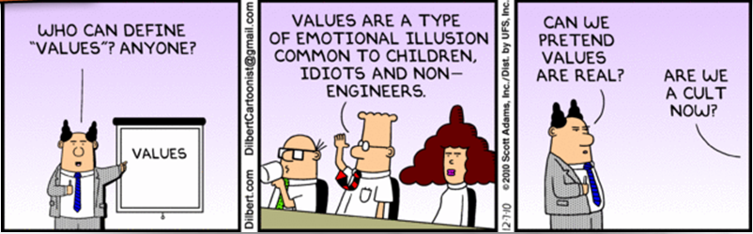
Value

Slide 3
How do we determine Value?
equivalent worth or return in money, material, services, etc.: to give value for value received.
the worth of something in terms of the amount of other things for which it can be exchanged or in terms of some medium of exchange.
the desirability of a thing, often in respect of some property such as usefulness or exchangeability; worth, merit, or importance

Slide 4
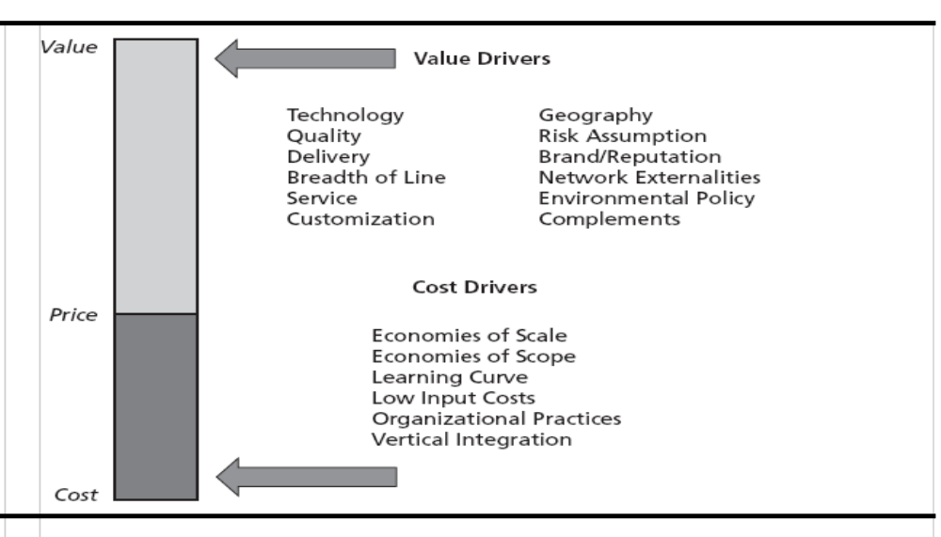
Value, Price and Cost (VPC) drivers
Economics
WTP
WTP – Willingness to Pay (what is it worth?)

Slide 5
Impacts to Value
Porter’s Five Forces Analysis
Threat of New Entry
Economies of scale
Proprietary product differences
Brand identity
Switching costs
Capital requirements
Access to distribution
Absolute cost advantages
Government policy
Expected retaliation
Bargaining Power
of Suppliers
Bargaining Power
of Customers
Differentiation of inputs
Switching costs
Presence of substitute inputs
Supplier concentration
Importance of volume to supplier
Cost relative to total purchases
Impact of inputs on cost or differentiation
Threat of forward integration
Rivalry Among Existing Competitors
Buyer concentration
Buyer volume
Buyer switching costs
Buyer information
Ability to integrate backward
Substitute products
Price / total purchases
Product differences
Brand identity
Impact of quality / performance
Buyer profits
Industry growth
Fixed costs / value added
Overcapacity
Product differences
Brand identity
Switching costs
Concentration and balance
Informational complexity
Diversity of competitors
Corporate stakes
Exit barriers
Threat of Substitutes
Relative price performance of substitutes
Switching costs
Buyer propensity to substitute
Source: Michael E. Porter, Competitive Advantage (New York: Free Press, 1985)

Slide 6
The Desirability of a Thing from the customer’s perspective
“Rule 17: Try honestly to see things from the other person’s point of view”
Dale Carnegie’s
Golden Book
What does the customer want?
Not what do we want to sell.

Slide 7
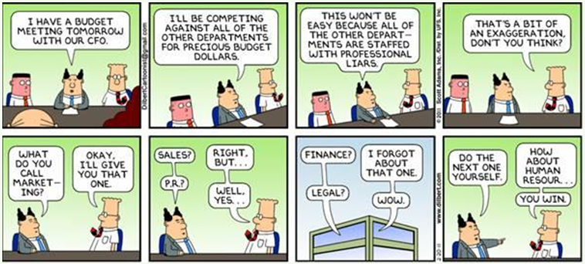
How does the customer see industry?

Slide 8
Who is the customer?
Does the customer know us?

Slide 9
What does the customer state are his wants?

Slide 10
What does the customer infer he wants? (What does the customer value?)

Slide 11
How are we going to give the customer what he wants?

Slide 12
How can we prove that we can deliver?

Slide 13
How is the customer going to benefit?
(WIIFM?)

Slide 14
Value Prop Template
Customer will “get”..”realize”..”enjoy”
Specific benefit
Because our approach, product, service provides
Added value statement
We have the ability to provide this value because
Proof of our ability.
Where have we done it before
Conclusion
Summary of value proposition

Slide 15
Example: Value Proposition
CBP will enjoy
an expanded breadth and depth in training for ever evolving tools and techniques as technology progresses.
Because our approach brings added value of
combining out strengths in detection phenomenology, instructional design and training.
We have proven this approach is effective
in the work we have performed in developing training for our implementations of our patented explosive detection systems, numerous biometric collection devices and our ever expanding sensor technology.
Conclusion
By coupling our instructional expertise with the underling science, we are able to provide the best available training.

Slide 16
Agenda
11:30 – 1:00 Strategy, What and Why
1:00 – 1:10 Break
1:10 – 2:30 Value, Price, and Cost
  Breakout exercise
2:30 – 2:45 Break
2:45 – 3:45 Strategy Execution
  Breakout exercise
3:45- 4:30 Wrap-up
4:30 – 5:00 Float

Slide 17
Strategy, What and Why

Slide 18
What kinds of questions does a well-articulated strategy answer?
How do resources and capabilities relate to our customer?
How do we integrate our operational and marketing efforts so that they reinforce each other?
Where do we need to make investments?
How can we reduce the number of missteps that we take?

Slide 19
How does having a strategy help our managers make decisions?
It neutralizes as much as possible the common biases in managerial choice.
It surfaces a range of innovations that might otherwise be left buried.
It stimulates new ideas.
It codifies management commitment.
It builds consensus.
It reduces organization drift.

Slide 20
How can we win without a strategy?
We can always play the reactionary role but is that winning?
Winning means that we beat every competitor.
Winning means that we get the largest share.
Winning means that we generate profit for our company and Value for our client.
We can not meet that standard of winning without a strategy.

Slide 21
Five key strategic concepts
How do we develop a successful strategy?
Economics: How profitable is it?
Sustainability: How defensible is it?
Uniqueness: How different is it?
Fit: How well does it align?
Trade-offs: How clear are its boundaries?

Slide 22
How do we achieve a profitable market position?
Economics

Slide 23
How do we defend our position?
Sustainability

Slide 24
Competitive Advantage
Creating Sustaining
Resources
Capabilities
Value Drivers
Cost Drivers
Retaining Customers
Preventing Imitation
Superior Market Position
Defendable Market Position
Sustainable Competitive Advantage

Slide 25
Why should we pursue uniqueness?
Uniqueness

Slide 26
Why should activities align?
Fit

Slide 27
Why should we choose what not to do?
Trade-offs

Slide 28
As the strategy matures, remember:
Economics: How profitable is it?
Sustainability: How defensible is it?
Uniqueness: How different is it?
Fit: How well does it align?
Trade-offs: How clear are it’s boundaries?

Slide 29
Where does Operational Innovation fit in?
Improved training?
Career Progression?
Portfolio of services?

Slide 30
Is price competition inevitable?
(and if so, what do you do about it?)
Increase perceived value to the client, increasing the willingness to pay.
Find better ways to discriminate our offerings from out competitors.

Slide 31
Strategic decisions are lumpy and risky
Significant and expensive, with lasting effects on possible future courses of action
  e.g.: acquisitions, product launches, capacity expansion, capability development, etc.
  Sunk costs lock the firm in; opportunity costs lock the firm out
Strategically important decisions are hard to reverse
  Require real commitment to seeing them succeed
  Time lags prevent us knowing outcomes for some time
  Uncertainty always a problem; big wins, big losses
This is why managers investigate before committing
  Fully developed business cases
  Experiments and pilot studies

Slide 32
Crafting strategy is a process, not an event
A good strategy evolves regularly
  A firm pleases customers, wins orders, makes $; but, competitors react
  A lousy strategy is abandoned as competitors maneuver
Strategy is future-oriented; anticipating and perhaps shaping what will likely come
  Efficiency and flexibility leave you forever playing catch-up ball

Slide 33
10 Minute Break

Slide 34
Value, Price and Cost

Slide 35
Value, Price and Cost (VPC) drivers

Slide 36
Which forces effect VPC?
Strength of competitive rivalry
Potential for entry into the industry by new competitors
The negotiating power of buyers
The negotiating power of our suppliers
The strength of substitutes or other vehicles

Slide 37
1. How does intense competition affect VPC?
More intense competitive rivalry…
  May reduce price, while holding value and cost constant
  May increase value (+cost) without increasing product prices
How do we reduce competitive rivalry?
  Cutting costs (in ways customers don’t notice) may stop rivals from trying to compete on price (retaining higher profitability)
  Compete on non-price dimensions
    Differentiating product reduces competitive pressures on price
    Imitability the key to differentiation; how good is our defense?
  Even if replicable, ongoing innovation in value or cost drivers can reduce competitor pool if mis-steps lead them to exit
  Create switching costs (that customers don’t notice or mind)
  Focus on niches, market segments with competitive advantage

Slide 38
2. How do low barriers to entry affect VPC?
Low barriers to entry…
  May reduce prices while holding value and cost constant
  May increase costs by bidding up resources (pass-thru to prices)
How do we raise barriers to entry?
  Decrease costs and prices through investments in scale
  Design switching costs into our offering
  Increase barriers to imitation
    Establish property rights, acquire dedicated assets, increase causal ambiguity, increase learning and development costs
  Signal ferocious rivalry through credible threats
    Willingness to take losses for a long time (deeper pockets)
    Huge investments in capacity (burn the ships)

Slide 39
3. How does buyer power affect VPC?
Powerful buyers…
  Increase the value (and cost) required to compete
  Reduce the price required to compete
How can we reduce buyer power?
  Avoid falling in trap of serving small number of buyers
  Differentiate product from competitors’
  Reduce dependence by serving multiple market segments
  Help buyer structure value chain around product’s unique features
  Branded demand stimulation with end customers
  Reduce buyer’s threat of backward integration
  Consider forward integration into buyer’s industry
  Avoid investments in capacity expansion (unless they can lower prices and decrease buyer power by driving out competitors)

Slide 40
4. How does supplier power affect VPC?
Powerful suppliers…
  Increase costs
  May decrease value a firm can offer to customers
How can we reduce supplier power?
  Aggregate orders into very large, infrequent purchases
  Innovate to develop substitute production processes that do not rely on traditional suppliers
  Develop credible threat of backward integration (or actually do it)
  Avoid branding efforts by supplier to end customers
  Resist relying on differentiated features of supplier’s products

Slide 41
5. How do substitutes affect VPC?
Powerful, viable substitutes…
  Increase value required to compete
  Lower price required to compete
How do we reduce the threat of substitutes?
  Find ways to boost value by less than cost of doing so, or lower cost by more than the associated impact on value
  Raise buyer’s switching costs for your product (unique features, brand loyalty) or for your industry (branding your product class)
  Be the first to create substitutes (shoot your own dog)
  Acquire patents developed by potential substitutes
  Organize a collective industry response (we’re all in same boat)

Slide 42
Breakout
How can we reduce competitive rivalry?
How do we raise barriers to entry?
How can we reduce buyer power?
How can we reduce supplier power?
How do we reduce the threat of substitutes?

Slide 43
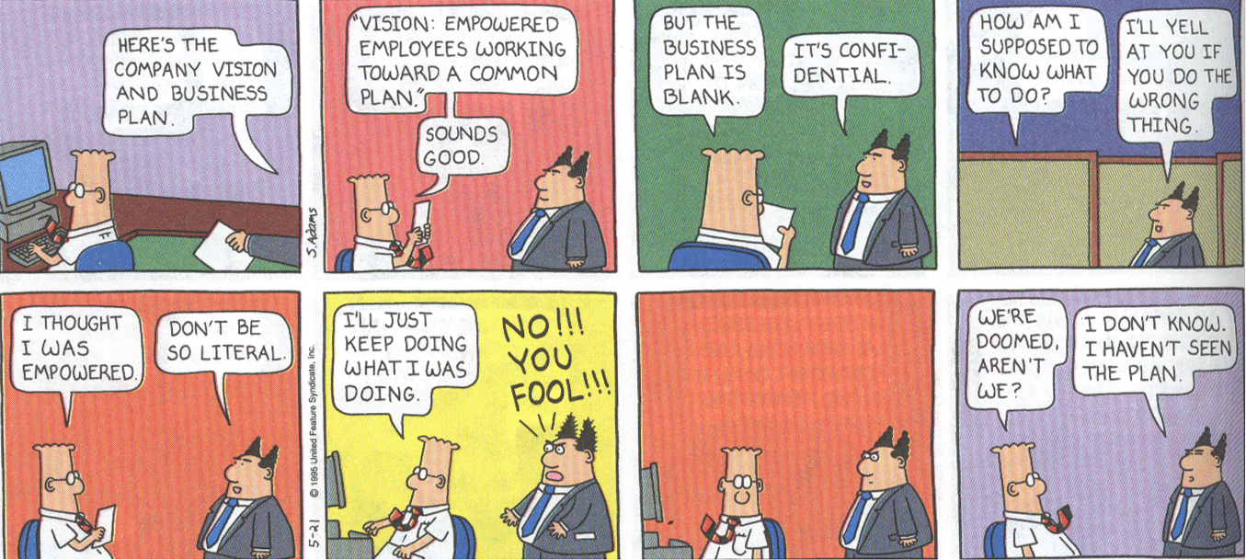
Quick 15-minute break

Slide 44
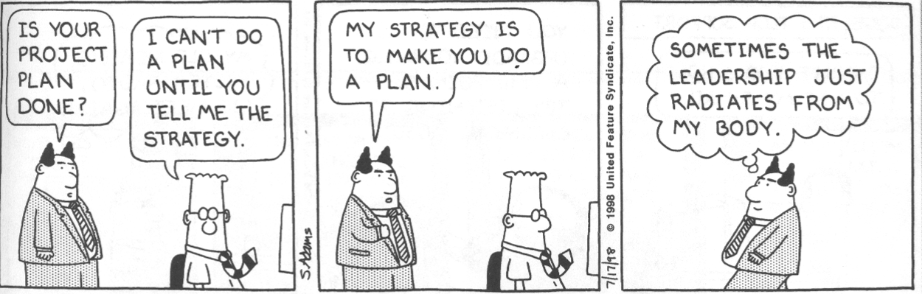
Strategy Execution

Slide 45
What’s a “sustainable” competitive advantage?
Competitive advantage means having
  A larger gap between value and cost than competitors, and
  Good defenses to preserve that gap
A sustainable competitive advantage persists for a while in the face of competent competitors
  Ideally, long enough that competitors stop trying to duplicate it
  Strategic thinking is important, but useless without execution
  Great ideas for new products & services matter a whole lot less than having the resources & capabilities necessary to produce them more profitably then competitors

Slide 46
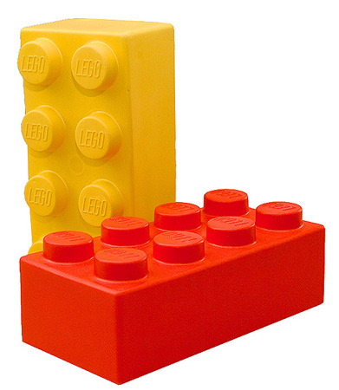
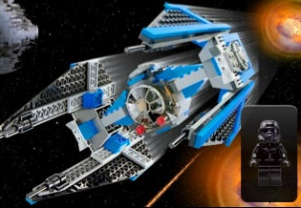
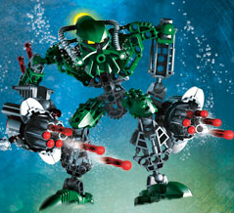
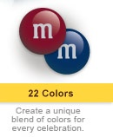
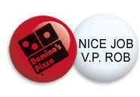
Figuring out the right resource or capability to invest in can be profitable

Slide 47
Expected Returns to
Resources & Capabilities
Valuable? | Rare? | Costly to Imitate? | Exploited by the Org’n? | Competitive Implications | Economic Performance
No | -- | -- | -- | Competitive Disadvantage | Below Normal
Yes | No | -- | -- | Competitive Parity | Normal
Yes | Yes | No | -- | Temporary Competitive Advantage | Above Normal
Yes | Yes | Yes | Yes | Sustained Competitive Advantage | Above Normal

Slide 48
Breakout
What resources do our customers need that we can’t currently deliver?
What technologies do we need to do our job better
What processes are working and which are not working
Which customers are we serving and which ones are not using our services

Slide 49
Wrap up

Slide 50
Why are identical resources worth more to some firms than to others?
One firm can derive more profit from a resource than another firm when it has:
  Stronger complementarities between existing resources and the resource to be acquired
  A better ability to forecast the economic returns possible through owning the resource
  Stronger capabilities that increase the returns to the resource
Same argument can be made for capabilities

Slide 51
Why might smart investments cost more to copy?
Competitors must pay more to acquire same resources and build same capabilities because of:
  Your investment revealed true value
  Limited supply
  Time compression diseconomies
  Asset mass efficiencies
  Causal ambiguity
  Social complexity
This is why attempts to copy are rarely perfect
  Though they often do succeed in driving down prices

Slide 52
If you could copy competitor’s capability perfectly, is this a smart move?
Imitation of a leader’s capabilities
  Will not lead to sustainable competitive advantage
  But, may keep you in the game
  Often requires scale economies to succeed
Consider developing substitute capabilities
  Requires creativity/insight; no example to follow
  Must be able to develop at attractive cost
  All the logic of substitute products applies; can this differentiate us? Hard to imitate? Bigger wedge?

Slide 53
How do we assess whether something adds economic value?
Not just “is valuable” (as in “could be sold for $”)
  Rather, “adds value” = wedge between WTP and cost
    (as we know, effect on price is a function of market mechanisms)
Two analysis techniques help with this question:
  Value chain framework – break processes down into component activities, use ABC to fully cost them, estimate effect on WTP
  Activity system framework – understand the specific reinforcing effects of different pieces of the organization

Slide 54
Connecting Willingness to Pay (WTP) → VC Activities
Identify end customer segments
Market research to identify their specific needs
How well are we (& others) fulfilling these needs?
How much would customers pay for different value additions? (often a guesstimate in consumer markets)
Prioritize options based on ability to differentiate
What activities are required to fulfill these needs?
Which resources & capabilities enable us to carry out those activities?

Slide 55
Activity systems
(Align with the mission)
Is there a broader collection of interconnected tasks that could contribute to its market position
  Policies
  Value chain activities
  Product characteristics
  Key resources
  Our structure and culture
A more complex (but realistic) way of analyzing activities
  Shows dependencies, not just classification system
  Shows how activities reinforce each other

Slide 56
Lessons Learned
Our competitors play the same game
    There are few low-hanging fruit; requires creativity
    Obtaining resources/capabilities at a lower cost than future value always a gamble; sometimes dumb luck, or slow competitors
Our employees play the same game
    Internally retained value often dissipates through slack & hold-up
Breakthrough ideas are often re-combinations
    Using capabilities in new ways, in conjunction with strengths
Uncertainty and turbulence create opportunities
    Need better foresight and faster reactions to win at this game

Slide 57
Questions?

